Slide 1


VIDYA VIKAS INSTITUTE OF ENGINEERING AND TECHNOLOGY #127-28, Bannur Road, Aalanahally Post, Mysuru-570028 DEPARTMENT OF COMPUTER SCIENCE AND ENGINEERING Internship Presentation on “SMART CONTACT MANAGEMENT” By HITHESH C H [4VM18CS017]
Under the guidance of
Internal Guide External Guide
Prof . Madhusudhan G K Ranjith
Assistant Professor , Dept of CSE Tecnotree Academy

Slide 2
CONTENTS
About the Company
Introduction
Problem statement and proposed solution
Methodology
Design
System Requirements
Reflection
Results & Conclusion
certificate
References

Slide 3

About the company
Tecnotree Corporation is Finnish vendor of software to telecommunications service providers. It operates in the BSS sector.
As Tecnotree is the only full-stack digital BSS provider with over 40 years of deep domain knowledge, proven delivery and transformation capability across the globe.
Tecnotree deliver omnichannel customer experiences with signature Finnish design and quality excellence. Our customers use our products to establish a dynamic ecosystem that offers highly relevant solutions to people..
Department of computer science and engineering

Slide 4
Introduction
The Smart contact management system is a web application
That will help us to store and secure the user credentials and contacts of the user
The project is developed using pring boot which enables the user to add, update, delete the contacts of the user and enable multiple user to login and maintains their data.
The main objective of the project is to help people to maintain their contacts in an efficient manner.

Slide 5
Problem statement
The current contact manger enables single user to manage his contacts.
Security aspect might be missing.
The contacts might be written in a book and kept.

Slide 6
Proposed Solutions
The proposed a system enables to store and secure contacts in an efficient manner.
The user details and contacts are stored in the database in a secure way.
User can login only if he has registered and can access only if the password and the email id entered is correct.
Advantages:
Security is achieved
Enables Privacy
Easy access and retrieval.

Slide 7
Methodology
Register if you are a new user, Login if you have already registered.
Dashboard will be displayed.
Click on add contact to add new contact.
Your profile to view the list of contacts
Update to modify the entered details.
Delete to remove the contact.
Logout to exit.

Slide 8
Design
Browser
User Registration Controller
User Service
User Repository
MySQL
REGISTRATION

Slide 9
Application Architecture
Thyme leaf
User Registration Controller
User Service
User Repository
MySQL
Frontend
Backend
Database

Slide 10
Block diagram
Return to login
Login fail
Request login
Authentication
Login
User
Database
Registered
Store data into database
Retrieve data from database
Add contacts
Logout
Department of computer science and engineering

Slide 11
User Registration
Valid User details
User registration
No
Submit
Yes
Yes
Database
Accept terms & conditions
Yes
Reset

Slide 12
User login
login
No
If username and password
If correct otp
No
Forget password
Valid email
Enter otp
Yes
Set new password
Yes
submit
User dashboard

Slide 13
System Requirements
HARDWARE REQUIREMENTS SOFTWARE REQUIREMENTS
Processor : intel 4 + OS : Windows 7 or Higher
RAM : 4GB Back End : MySQL Server
Hard Disk : Minimum of 80 GB Front End : Thymleaf
Speed : 1.2 GHz+ Tool Kit : Spring tool suit

Slide 14

Reflection
During the internship I came to about the various technologies that can be used to create a web application. I had no idea about spring boot before the internship and now I have learnt the basics of it and can develop simple projects using it.
These are the following technologies that we have worked and learnt during our internship:
MySQL workbench
Spring boot
Thyme leaf
Spring tool suite

Slide 15
Result and Conclusion
I learned various technologies during this internship.
I applied all the concepts which I learned in this project .
There were difficulties in understanding the basics which I could eventually overcome in the course of time by practicing and implementing simple projects.

Slide 16
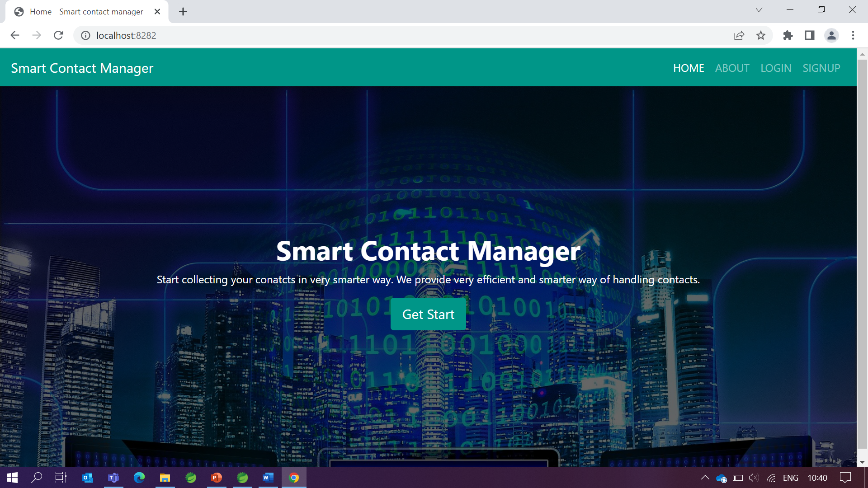
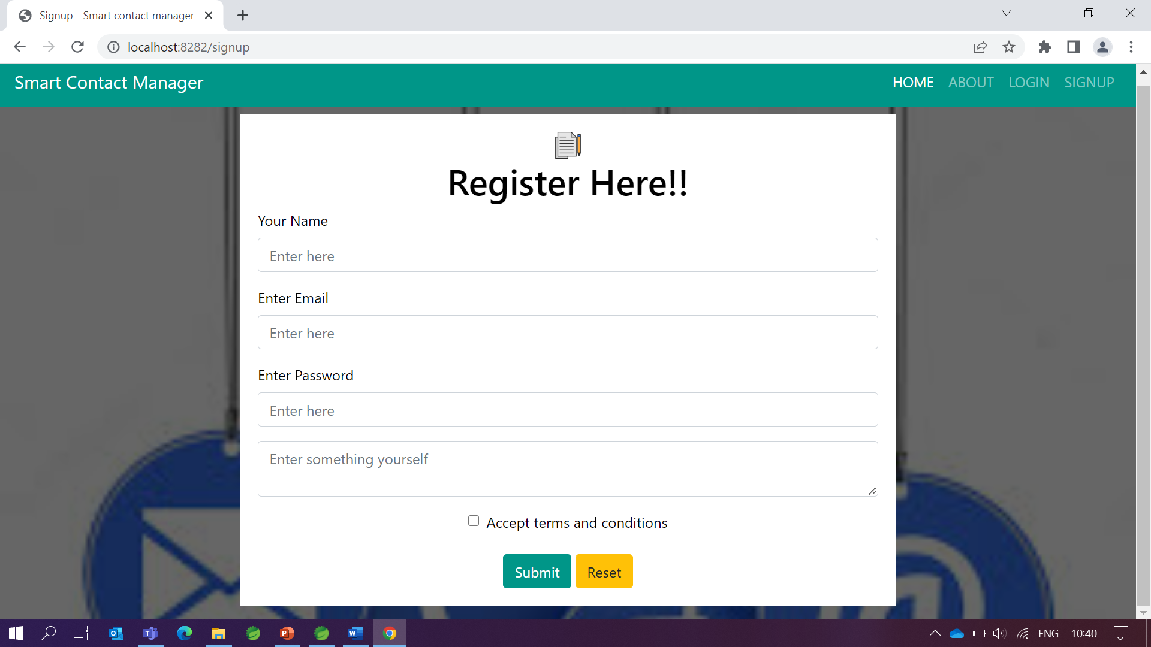
Implementation
Home page
Sign up page

Slide 17
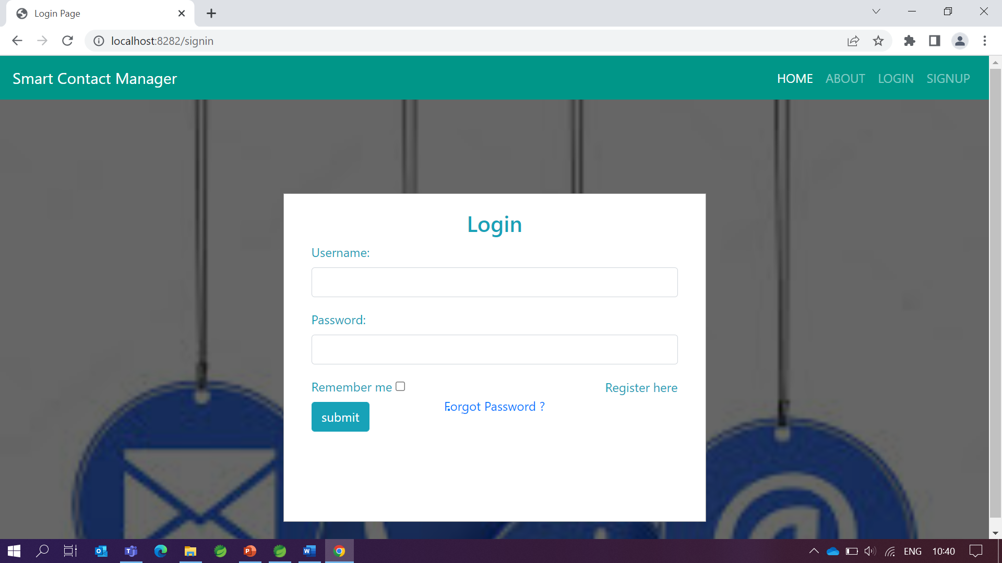
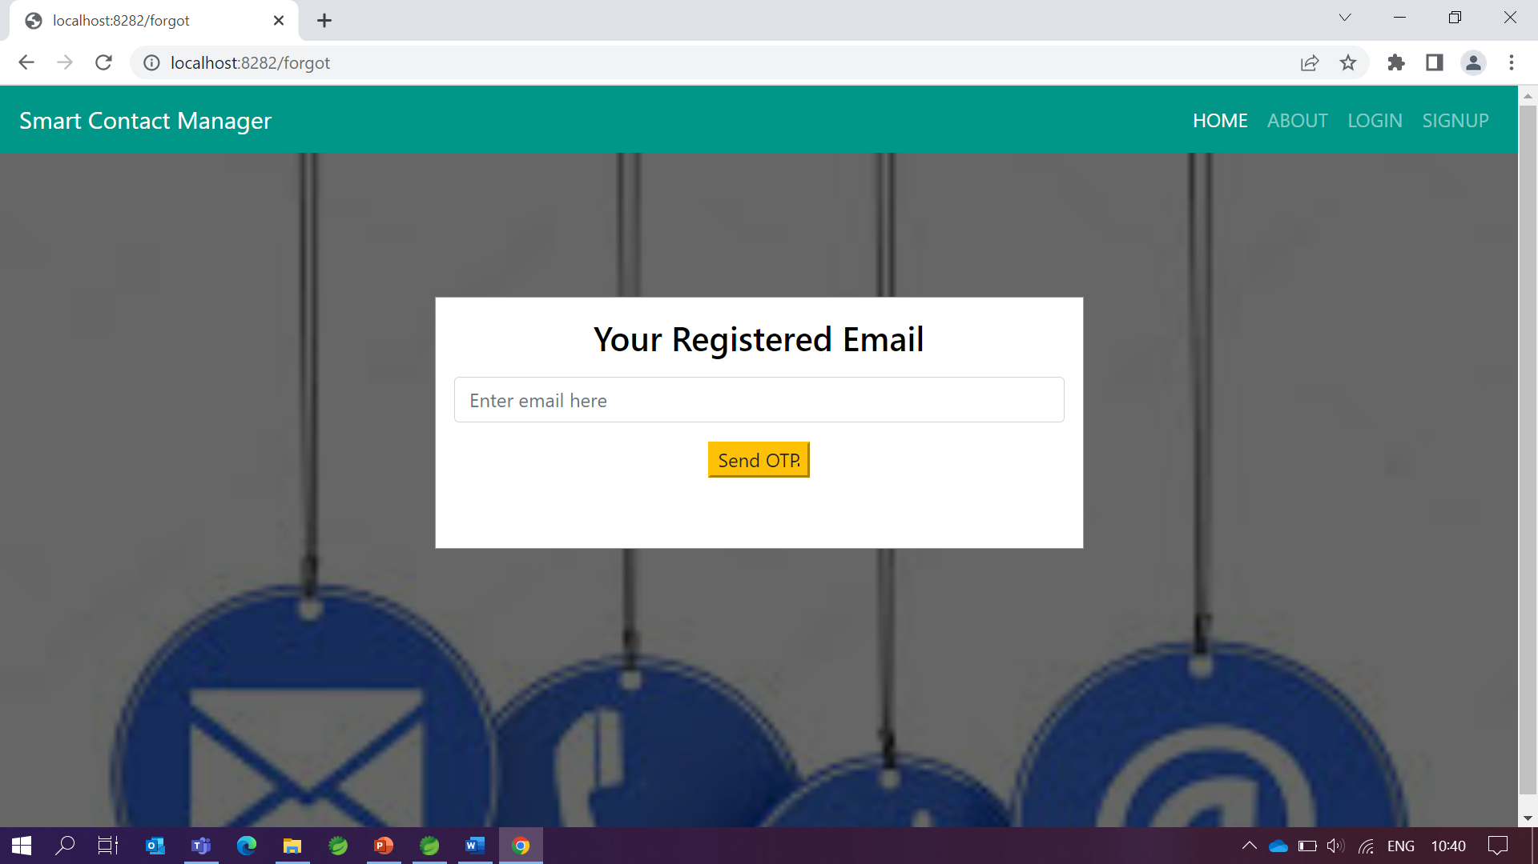
Implementation
login page
Forgot password page

Slide 18
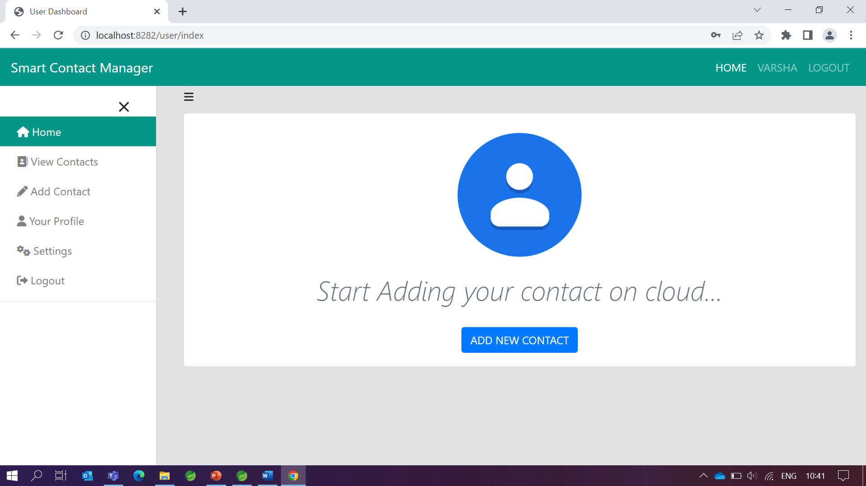
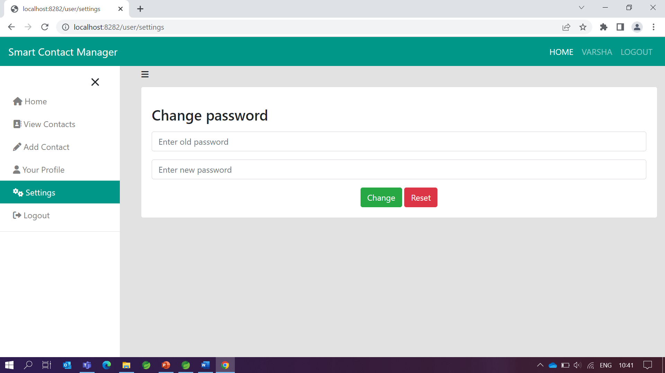
Implementation
User dashboard page
change password page

Slide 19
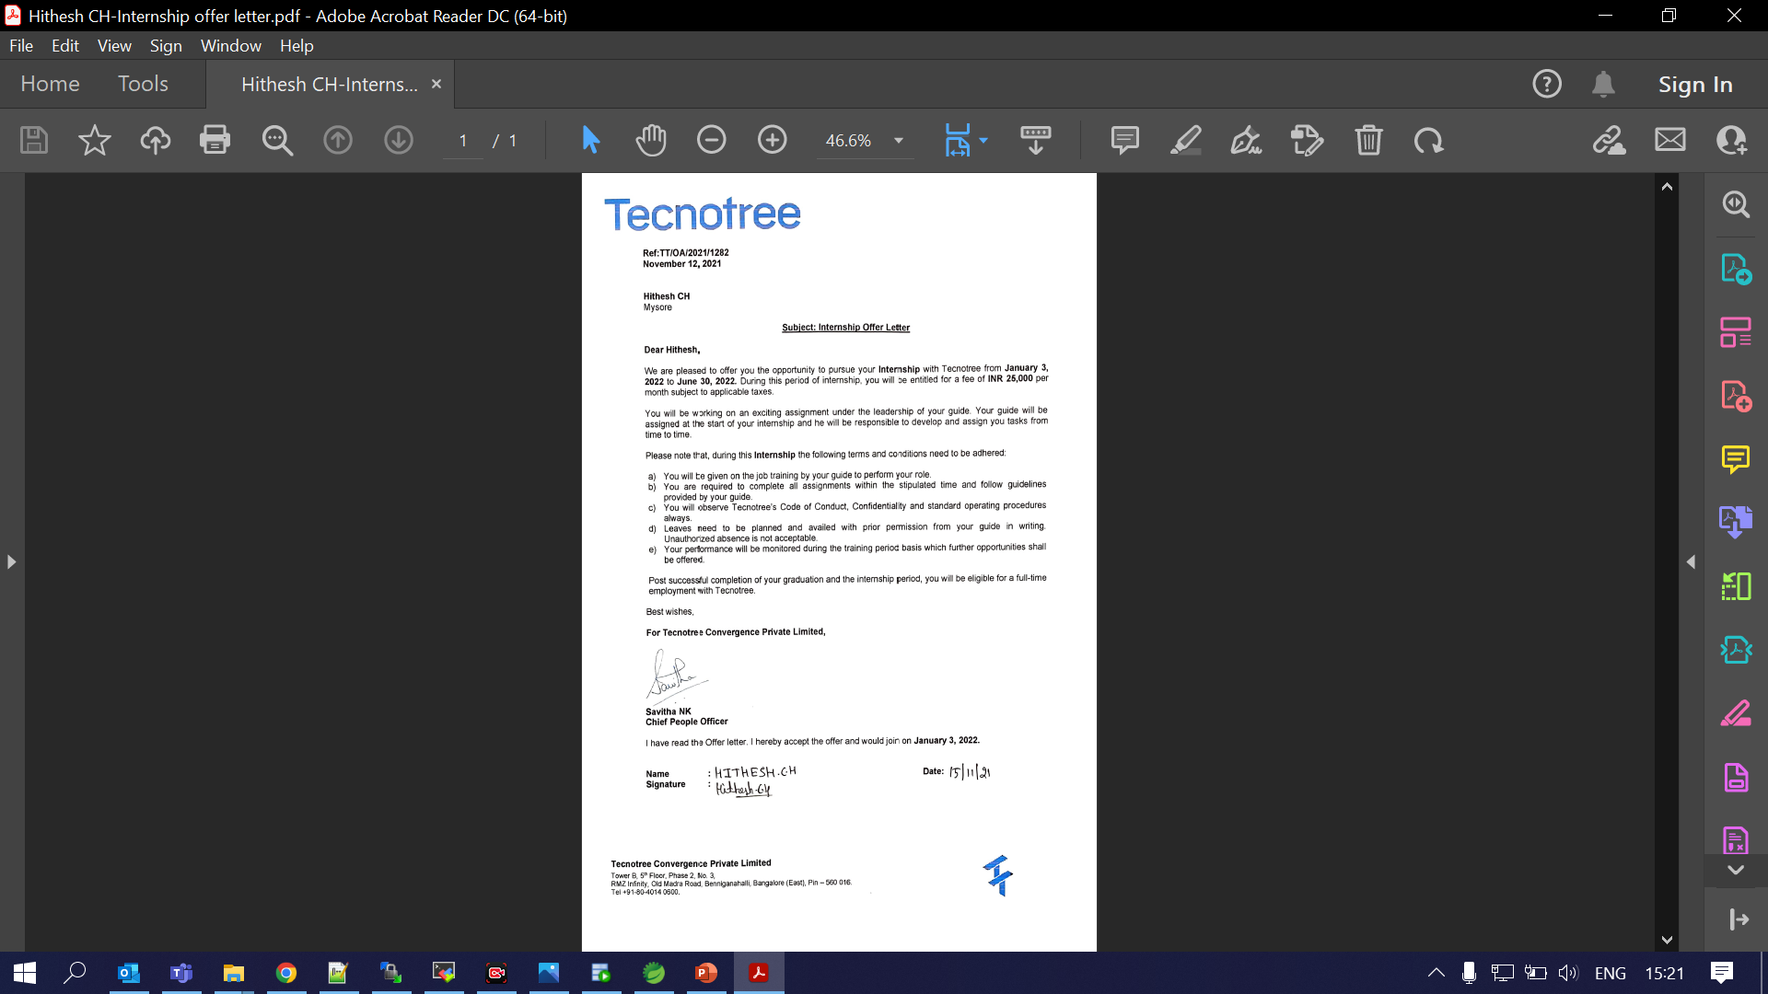
Certificate

Slide 20

References
https://docs.spring.io/spring-boot/docs/current/reference/htmlsingle/
Udemy/spring-projects
https://www.w3schools.blog/spring-boot-tutorial

Slide 21
Thank you

